Slide 1
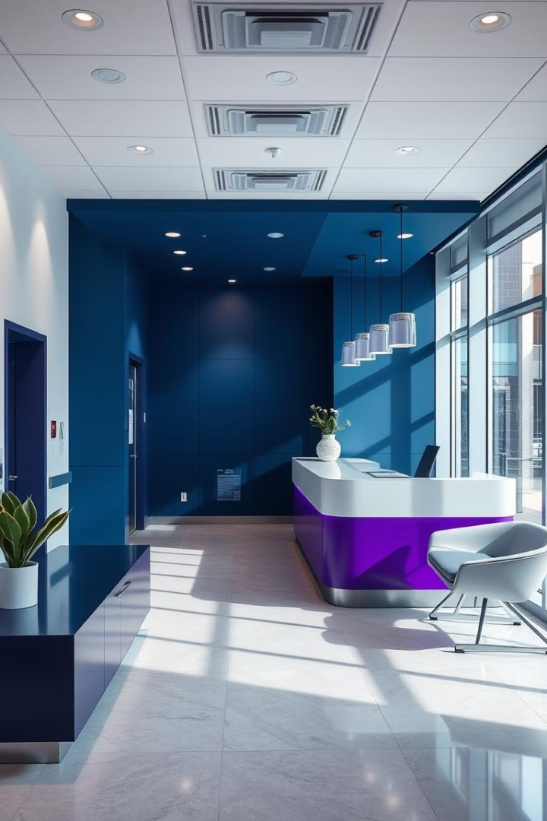
Medical Clinic Management System
Focus: Design Patterns and Architecture
Team Members
Bahaa Mahmoud Helmy – ID: 2100550
Abdalla Shreif – ID: 2100242
Maram Mohamed Ahmed – ID: 2100966
Reham Ahmed Thabet Essa – ID: 21-01496

Slide 2

Why Use Design Patterns?
Code reusability
Proven solutions
Increase readability across projects
Solve recurring software problems
Scalability & Maintenance
Cross-layer use
Design systems that grow easily
Applies to UI, logic, and database

Slide 3
Factory Pattern
Use Case
Example Classes
Benefits
Creates user roles and specializations
Factory_Role
Centralizes object creation, ease of extension
Factory_DoctorSpecialization

Slide 4
Builder Pattern
Purpose
Why Use
Advantage
Build complex patient profiles and appointments
Flexible construction for optional and required fields
Cleaner, readable object building process

Slide 5

Singleton Pattern
Use Case
Example
DB connection management with single instance
DBConnection.getInstance()
Benefit
Prevents redundant DB access, improves performance

Slide 6
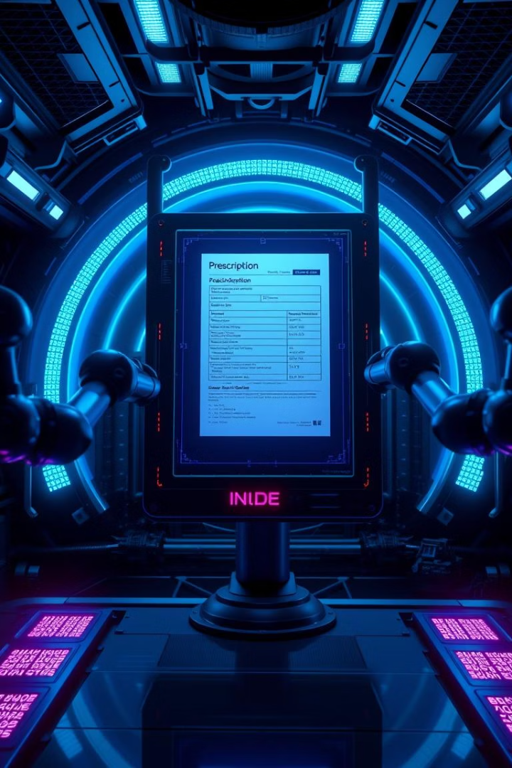
Prototype Pattern
Use Case
Why
Cloning recurring appointments and prescriptions
Faster creation when fields are repetitive
Benefit
Saves time and memory consumption

Slide 7
Adapter Pattern
Purpose
Scenario
Benefit
Integrate external health APIs and modules
Converts incompatible interfaces to work together
Enhances flexibility without code changes

Slide 8

Database Abstraction
Class
DBManager
Role
Handles all CRUD operations centrally
Benefits
Separates data layer from business logic
Pattern Type
Architectural abstraction

Slide 9
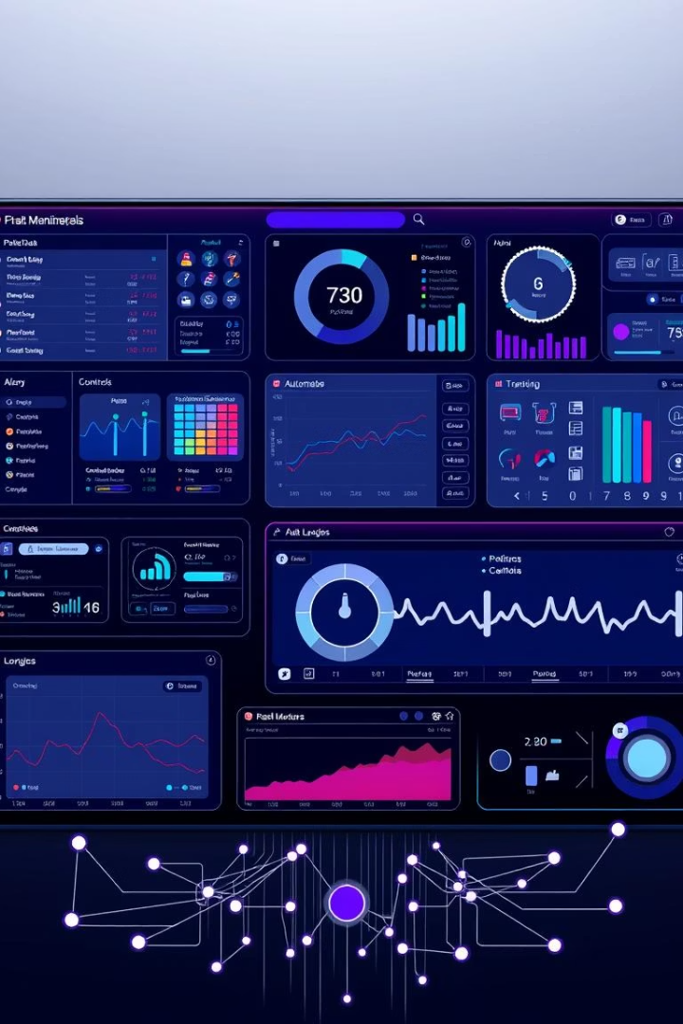
GUI Abstraction
Approach
Use Cases
Separate UI controls from business logic
JavaFX, Swing, or Web front-end
Benefit
Easier UI updates without logic impact

Slide 10
Conclusion
Design Patterns Used
Benefits
Outcome
6 standard patterns plus 2 architecture strategies
Made system modular, clean, extensible
Ready for scaling and deployment

Slide 11
Thanks For Listening
Any Questions..?

